Slide 1
Writing Persuasive Messages
© Prentice Hall, 2004
Business Communication Essentials
Chapter 9 - ‹#›
Notes:
‹#›

Slide 2
Three-Step Writing Process
1
Planning
2
Writing
3
Completing
Analyze the
Situation
Organize the
Message
Revise the
Message
Investigate the
Topic
Compose the
Message
Produce the
Message
Adapt to the
Audience
Proofread the
Message
© Prentice Hall, 2004
Business Communication Essentials
Chapter 9 - ‹#›
Notes:
‹#›
Savvy business people often use techniques of persuasion—the attempt to change an audience's attitudes, beliefs, or actions. “Quite simply, effective persuasion is the ability to present a message in a way that will lead others to support it,” says Jay Conger, author of Winning ’Em Over. “It makes audiences feel they have a choice, and they choose to agree.
Whether you’re selling real estate or just trying to sell your idea to your boss, writing effective persuasive messages is indeed an important skill. In today’s competitive marketplace, applying the three-step writing process to your persuasive messages will help you make them as effective as possible.
1. Planning includes determining your purpose, analyzing your audience, and providing solid evidence.
2. Writing includes composing the main idea, developing relevant points, and choosing the right organizational approach.
3. Completing includes evaluating content, revising, checking overall design and delivery methods, and proofreading.

Slide 3
Analyze Your Purpose
Clear
Necessary
Appropriate
© Prentice Hall, 2004
Business Communication Essentials
Chapter 9 - ‹#›
Notes:
‹#›
Writing an external persuasive message is one of the most difficult tasks you could undertake. For one thing, your purpose is to persuade people to do something different or to try something new. But people are busy, so they're reluctant to act, especially if it takes time and offers no guarantee of any reward in return. For another, competing requests are plentiful. Given the complexity and sensitivity of persuasive messages, you must be absolutely sure that your purpose is clear, necessary, and appropriate for written media.

Slide 4
Gauge the Audience
Demographics
Psychographics
Gender
Personality
Income
Attitudes
Education
Lifestyle
Other Factors
Other Factors
© Prentice Hall, 2004
Business Communication Essentials
Chapter 9 - ‹#›
Notes:
‹#›
To assess various individual needs, you can refer to specific information such as demographics (the age, gender, occupation, income, education, and other quantifiable characteristics of the people you're trying to persuade) and psychographics (the personality, attitudes, lifestyle, and other psychological characteristics of an individual). Both types of information are strongly influenced by culture.

Slide 5
Consider Cultural Differences
Organizational
Differences
Individual
Differences
© Prentice Hall, 2004
Business Communication Essentials
Chapter 9 - ‹#›
Notes:
‹#›
Your understanding and respect for cultural differences will help you satisfy the needs of your audience and will help your audience respect you. That’s because persuasion is different in different cultures. In France, using an aggressive, hard-sell technique is no way to win respect. Such an approach would probably antagonize your audience. In Germany, where people tend to focus on technical matters, plan on verifying any figures you use for support, and make sure they are exact. In Sweden, audiences tend to focus on theoretical questions and strategic implications, whereas U.S. audiences are usually concerned with more practical matters.
As with individuals, an organization's culture or subculture heavily influences the effectiveness of messages. All the previous messages in an organization have established a tradition that defines persuasive writing within that culture. When you accept and use these traditions, you establish one type of common ground with your audience. If you reject or never learn these traditions, you'll have difficulty achieving that common ground, which damages both your credibility and your persuasion attempts.

Slide 6
Establish Credibility
Facts
Sources
Expertise
Common
Ground
Enthusiasm
Objectivity
Sincerity
Trust
Good
Intentions
© Prentice Hall, 2004
Business Communication Essentials
Chapter 9 - ‹#›
Notes:
‹#›
To persuade a skeptical or hostile audience, you must convince people that you know what you're talking about and that you're not trying to mislead them. Your credibility is your capability of being believed because you're reliable and worthy of confidence. Without such credibility, your efforts to persuade will seem manipulative.
Some of the best ways to gain credibility are as follows:
Support your message with facts.
Name your sources.
Be an expert.
Establish common ground.
Be enthusiastic.
Be objective.
Be sincere.
Be trustworthy.
Have good intentions.

Slide 7

Strive for High Ethical Standards
Provide information
Boost understanding
Promote free choice
Avoid manipulation
© Prentice Hall, 2004
Business Communication Essentials
Chapter 9 - ‹#›
Notes:
‹#›
Successful businesspeople make persuasion positive. They influence audience members by providing information and aiding understanding, which allows audiences the freedom to choose.
For anyone trying to influence people's actions, knowing the law is crucial. However, merely avoiding what is illegal may not always be enough. To maintain the highest standards of business ethics, make every attempt to persuade without manipulating. Choose words that won't be misinterpreted, and be sure you don't distort the truth. Adopt the "you" attitude by showing honest concern for your audience’s needs and interests.

Slide 8
Writing Persuasive Messages
Power or
Expertise
Define the Main Idea
Audience
Direct
Approach
Limit the Scope
Indirect
Approach
Purpose
Group Major Points
Organizational
Culture
© Prentice Hall, 2004
Business Communication Essentials
Chapter 9 - ‹#›
Notes:
‹#›
When writing persuasive messages, you will define your main idea, limit the scope of your message, and group your points in a meaningful way. But you must focus even more effort on choosing the direct or indirect approach.
Most persuasive messages use the indirect approach. That means you’ll want to explain your reasons and build interest before revealing your purpose. Nevertheless, many situations do call for the direct approach.
If audience members are objective, or if you know they prefer the “bottom line” first (perhaps it saves them time), the direct approach might be the better choice. You’ll also want to use the direct approach when your corporate culture encourages directness. In addition, when a message is long or complex, your readers may become impatient if the main idea is buried seven pages in, so you may want to choose the direct approach for these messages as well.
Your choice between a direct and an indirect approach is also influenced by the extent of your authority, expertise, or power in an organization.

Slide 9
Completing the Message
Evaluate
the Content
Revise for Clarity
and Conciseness
Evaluate Design
and Delivery
Proofread
the Message
© Prentice Hall, 2004
Business Communication Essentials
Chapter 9 - ‹#›
Notes:
‹#›
The length and complexity of persuasive messages make applying Step 3 even more crucial to your success. When you evaluate your content, try to judge your argument objectively and seriously appraise your credibility. When revising for clarity and conciseness, carefully match the purpose and organization to audience needs.
Your design elements must complement (not detract from) your argument. In addition, make sure your delivery methods fit your audience’s expectations as well as your purpose. Finally, meticulous proofreading will identify any mechanical or spelling errors that would weaken your persuasive message.

Slide 10

Logic and Emotions
Emotions
The Message
Logic
Promote Action
Understand Expectations
Overcome Resistance
Sell Your Point of View
Feelings
Sympathies
Needs
Analogy
Induction
Deduction
© Prentice Hall, 2004
Business Communication Essentials
Chapter 9 - ‹#›
Notes:
‹#›
Most persuasive messages include both emotional and logical appeals. Finding the right balance between the two types of appeals depends on four factors: (1) the actions you wish to motivate, (2) your reader’s expectations, (3) the degree of resistance you must overcome, and (4) how far you feel empowered to go in selling your point of view.
An emotional appeal calls on human feelings, basing the argument on audience needs or sympathies. However, emotional appeals aren’t necessarily effective alone. Emotion works with logic in a unique way: People need to find rational support for an attitude they've already embraced emotionally.
A logical appeal calls on human reason. In any argument you might use to persuade an audience, you make a claim and then support your claim with reasons or evidence. When appealing to your audience's logic, you might use three types of reasoning:
With analogy, you reason from specific evidence to specific evidence.
With induction, you reason from specific evidence to a general conclusion.
With deduction, you might reason from a generalization to a specific conclusion.

Slide 11

Attention
Interest
AIDA PLAN
Action
Desire
© Prentice Hall, 2004
Business Communication Essentials
Chapter 9 - ‹#›
Notes:
‹#›
Most persuasive messages follow the AIDA plan: an organizational plan that goes beyond the indirect approach used for negative messages. The opening does more than serve as a buffer; it grabs your audience’s attention. The explanation section does more than present reasons, and it’s expanded to two sections. The first incites your audience’s interest, and the second changes your audience’s attitude. Finally, your close does more than end on a positive note with a statement of what action is needed; it emphasizes reader benefits and motivates readers to take specific action. The AIDA plan follows:
Attention. Make your audience want to hear about your problem or idea. Find some common ground on which to build your case.
Interest. Explain the relevance of your message to your audience. Continuing the theme you started with, paint a more detailed picture with words. Get your audience thinking.
Desire. Make audience members want to change by explaining how the change will benefit them. Reduce resistance by answering in advance any questions the audience might have. If your idea is complex, explain how you would implement it. Back up your claims.
Action. Suggest the action you want readers to take. Make it more than a statement such as “Please send me a refund.” Remind readers of the benefits of taking action, and make taking action easy.

Slide 12
Getting Attention
News Items
Emotions
or Values
Features
and Benefits
Numbers
or Questions
Product
Samples
Stories and
Illustrations
Shared
Traits
Challenges
Solutions
© Prentice Hall, 2004
Business Communication Essentials
Chapter 9 - ‹#›
Notes:
‹#›
The following techniques can help you grab your audience’s attention:
A piece of genuine news. ”Mortgage rates have fallen to a 30-year low.”
A personal appeal to the reader's emotions and values. "The only thing worse than paying taxes is paying taxes when you don't have to.”
Your product’s most attractive feature along with the associated benefit. "New control device ends problems with employee pilferage!”
A Intriguing Number or provocative question. ”Here are three great secrets of the world’s most loved entertainers.””How would you like to get straight “A’s” this semester?”
A product sample. "Here's a free sample of the Romalite packing sheet.”
A concrete illustration with story appeal. "In 1985 Earl Doe set out to find a better way to process credit applications. His simple, thorough procedure was adopted by the American Creditors Association.”
A specific trait shared by the audience. "Busy executives need another complicated 'time-saving' device like they need a hole in the head!”
A challenge. "Don't waste another day wondering how you're going to become the success you've always wanted to be!”
A solution to a problem. "Tired of cold air rushing through the cracks around your windows? Stay warm and save energy with AAA Weather-stripping."

Slide 13

The Central
Selling Point
Building Interest
Study the
Competition
Know
the Product
Analyze
the Audience
© Prentice Hall, 2004
Business Communication Essentials
Chapter 9 - ‹#›
Notes:
‹#›
In the interest section of your message, highlight your product’s key selling point. Ask what the competition has to offer, what most distinguishes your product, and what most concerns potential buyers. The answers to these questions will help you select the central selling point, the single point around which to build your sales message. Build interest by highlighting this point, and make it stand out through typography, design, or high-impact writing.

Slide 14

Increasing Desire
Stress the
Main Benefit
Refer to
Other Benefits
Provide
Essential Details
© Prentice Hall, 2004
Business Communication Essentials
Chapter 9 - ‹#›
Notes:
‹#›
Mention your main benefit repeatedly, expanding and explaining as you go. Use both words and pictures, if possible. This main benefit is what will entice recipients to read on and take further action.
As you continue to stress your main benefit, weave in references to other benefits. Remember, sales letters reflect the "you" attitude through references to benefits, so always phrase the selling points in terms of what your product’s features can do for potential customers.
Keep in mind that you don’t need to provide every last detail as you explain product benefits. The best letters are short (preferably one but no more than two pages). They include enough detail to spur the reader’s interest, but they don’t try to be the sole source of information. Also, remember to use bullet points to highlight details whenever possible. You have to assume that your readers are pressed for time and are interested only in what matters most to them.

Slide 15

Motivating Action
Explain the Next Step
Create Urgency
Use a Post Script
Apply Good Judgment
© Prentice Hall, 2004
Business Communication Essentials
Chapter 9 - ‹#›
Notes:
‹#›
After you have raised enough interest and built the reader’s desire for your product, you’ll want to clearly explain how to take the next step. After all, the overriding purpose of a sales letter is to get your reader to do something.
Whatever you ask readers to do, try to persuade them to do it right away. Convince them that they must act now, perhaps to guarantee a specific delivery date. Offer a free trial, an unconditional guarantee, or a no-strings request card for information.
Of course, adding a post script (P.S.)is one of the most effective ways to boost audience response. Use the P.S. to reiterate your primary benefit, make an additional offer, or compel the reader to act fast by emphasizing a deadline.
Finally, use good judgment when distributing your messages to would-be customers. Do not send electronic junk mail (spam). Doing so only irritates consumers, and it can be illegal.

Slide 16

Persuasive
Requests
Types of Messages
Action
Requests
Claims and
Adjustments
© Prentice Hall, 2004
Business Communication Essentials
Chapter 9 - ‹#›
Notes:
‹#›
People write innumerable persuasive requests inside and outside an organization. The most important thing to remember when preparing a persuasive request is to keep your request within bounds. Nothing is as distressing as a request so general, so all encompassing, or so inconsiderate that it seems impossible to grant, no matter how worthy the cause. Therefore, when making a persuasive request, take special care to highlight both the direct and the indirect benefits of fulfilling it.
The next two slides cover two types of persuasive messages:
Requests for action
Requests for claims and adjustments

Slide 17
Requests for Action
Gain
Attention
Written
Request
Use Facts,
Figures and Benefits
Action
Request Some
Specific Action
© Prentice Hall, 2004
Business Communication Essentials
Chapter 9 - ‹#›
Notes:
‹#›
Whether you’re requesting a favor or a budget increase, remember to use the AIDA plan to frame your message. Begin with an attention-getting device. Show readers that you know something about their concerns and that you have some reason for making such a request.
Use the interest and desire sections of your message to cover what you know about the situation you're requesting action on: the facts and figures, the benefits of helping, and any history or experience that will enhance your appeal. Your goals are (1) to gain credibility for you and your request and (2) to make your readers believe that helping you will indeed help solve a significant problem.
Once you've demonstrated that your message is relevant to your reader, you can close with a request for some specific action.

Slide 18
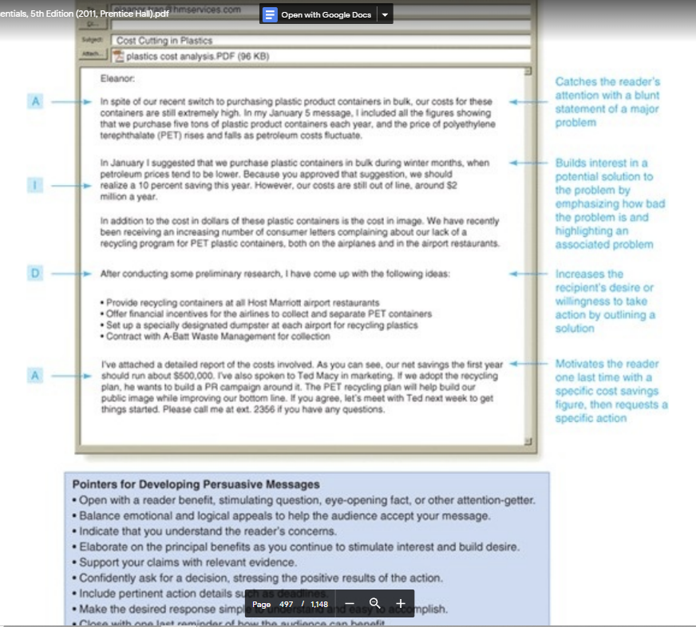
© Prentice Hall, 2004
Business Communication Essentials
Chapter 9 - ‹#›

Slide 19
Claims and Adjustments
State the Problem
Review the Facts
Written
Request
Claim or
Adjustment
Motivate the Reader
Make Your Request
© Prentice Hall, 2004
Business Communication Essentials
Chapter 9 - ‹#›
Notes:
‹#›
Most claim letters are routine messages and use the direct approach; however, some require persuasion. Fortunately, most people in business are open to settling your claim fairly and quickly.
The key ingredients of a good persuasive claim are a complete and specific review of the facts and a confident and positive tone.
Begin persuasive claims by stating the basic problem (or with a sincere compliment, rhetorical question, agreeable assertion, or brief review of what's been done about the problem). Include a statement that both you and your audience can agree with or that clarifies what you wish to convince your audience about. Be as specific as possible about what you want to happen.
Next, give your reader a good reason for granting your claim. Show how your audience is responsible for the problem, and appeal to your reader’s sense of fair play, goodwill, or moral responsibility. Explain how you feel about the problem, but don’t get carried away, don't complain too much, and don’t make threats. Make sure your request is calm and reasonable.
Finally, state your request specifically and confidently. Make sure your request proceeds logically from the problem and the facts you’ve explained. Be sure to specify a deadline for action (when necessary or desirable). And don’t forget to remind your audience of the main benefit of granting your claim.

Slide 20
Sales and Fundraising Messages
High
Low
For-Profit
Organizations
Personal Consumption
Helping Others
Non-Profit
Organizations
Low
High
© Prentice Hall, 2004
Business Communication Essentials
Chapter 9 - ‹#›
Notes:
‹#›
Two distinctive types of persuasive messages are sales and fundraising messages. These messages are often sent in special direct-mail packages that can include brochures, reply forms, or other special inserts. Both types of messages are often written by specialized and highly skilled professionals.
How do sales messages differ from fundraising messages? Sales messages are usually sent by for-profit organizations persuading readers to spend money on products for themselves. However, fundraising messages are usually sent by nonprofit organizations persuading readers to donate money or time to help others. Aside from these differences, sales and fundraising messages are quite similar. Both require a few more steps than other types of persuasive messages, and both generally used the AIDA sequence.

Slide 21
Sales Message Strategies
Emphasizing
Selling Points
Stressing Benefits
Remembering
Legal Issues
© Prentice Hall, 2004
Business Communication Essentials
Chapter 9 - ‹#›
Notes:
‹#›
Sales letters require you to know your product’s selling points and how each one benefits your particular audience. Selling points are the most attractive features of an idea or product. Benefits are the particular advantages that readers will realize from those features. Selling points focus on the product. Benefits focus on the user. You’ll need to highlight these points when you compose your persuasive message.
When composing sales messages, be sure to focus on relatively few product benefits. Ultimately, you'll single out one benefit, which will become the hallmark of your campaign.
Whether you're selling a good, a service, or your company’s image, knowing the law can help you avoid serious legal problems. Following the letter of the law isn't always enough. You’ll want to write sales letters of the highest ethical character. In addition, consider legal issues such as the following:
Letters as contracts. In many states, sales letters are considered binding contracts.
Facts about fraud. Misrepresenting the price, quality, or performance of a product in a sales letter is fraud.
Invasion of privacy. Using a person's name, photograph, or other identity in a sales letter without permission usually constitutes invasion of privacy.

Slide 22
Sales Message Strategies
Using Action
Terms
Talking
About Price
Supporting
Your Claims
© Prentice Hall, 2004
Business Communication Essentials
Chapter 9 - ‹#›
Notes:
‹#›
Action words give strength to any business message, but they are especially important in sales letters. Use colorful verbs and adjectives that convey a dynamic image to keep readers interested, but, be careful not to overdo it.
Price is a complicated, sensitive issue. So you need to be careful whenever you talk about price in your sales messages. Whether you highlight or downplay the price of your product, prepare your readers for it. If price is not a major selling point, you could leave the price out altogether or mention it only in an accompanying brochure. You could de-emphasize the price by putting the actual figures in the middle of a paragraph that comes close to the end of your sales letter, well after you've presented the benefits and selling points.
Providing support for you claims boosts your credibility and increases desire for your product. Support is especially important if your product is complicated, costs a lot, or represents some unusual approach.

Slide 23


Writing
Fundraising
Messages
Analyze the
Audience
Study the
Competition
Clarify Benefits
Keep the
Message Personal
© Prentice Hall, 2004
Business Communication Essentials
Chapter 9 - ‹#›
Notes:
‹#›
Most of the techniques used to write sales letters can also be used to write fundraising letters, as long as your techniques match your audience, your goals, and the cause or organization you're representing. Establish value in the minds of your donors by including "what's in it for me?" information.
Read the mail you receive from donors. Learn as much as you can about your audience by noting the tone of these letters, the language used, and the concerns raised. This exercise will help you write letters that donors will both understand and relate to.
You might also keep a file of competing fundraising letters. Study these samples to find out what other fundraisers are doing and what new approaches they're taking. Most important, find out what works and what doesn't.
Before you start writing, know whose benefits to emphasize. Make a two-column list; on one side list what your organization does, and on the other side list what your donors want. You'll discover that the two columns are quite different. Make sure that the benefits you emphasize are related to what your donors want, not to what your organization does.
Because fundraising letters depend so heavily on emotional appeals, keep your message personal. A natural, real-life lead-in is usually the best. People seem to respond best to slice-of-life stories. Also avoid making your letter sound like business communication, wasting space on warm-ups, and assuming your goals are more important than your reader’s goals.

